Slide 1
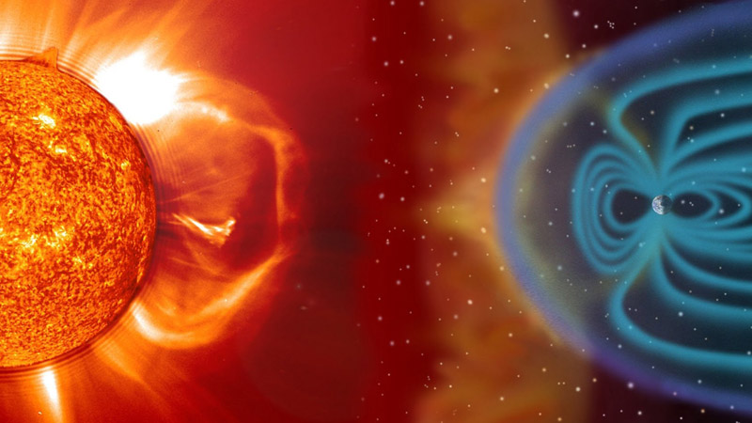
The effect of the solar wind on the Earth’s magnetosphere

Slide 2
content
1) Introduction
2) Study sample dataset
3) Calculate radius magnetopause
4) Study maximum sunspot number observed in solar cycle 23,24
5) Prediction model on solar cycle 25 2023:2030
6) Visualization radius magnetopause from 1996 to 2030
7) Data sources

Slide 3
1) Introduction
Space weather, influenced by the Sun, affects Earth’s technology and environment.
Solar phenomena like sunspots, solar flares, and solar winds can disrupt Earth’s magnetic field.
However, Earth’s magnetosphere acts as a shield, protecting us from most of the solar wind.
Understanding space weather is vital for protecting our technology and health.

Slide 4
solar wind
The solar wind, a stream of charged particles from the Sun’s corona, is composed mainly of electrons, protons, and alpha particles, with trace amounts of heavy ions and atomic nuclei.
This plasma escapes the Sun’s gravity due to its high energy and temperature, reaching speeds of 250–750 km/s.
When it reaches Earth, it interacts with the magnetosphere, causing auroras at the poles.

Slide 5


2) Study sample dataset

Slide 6
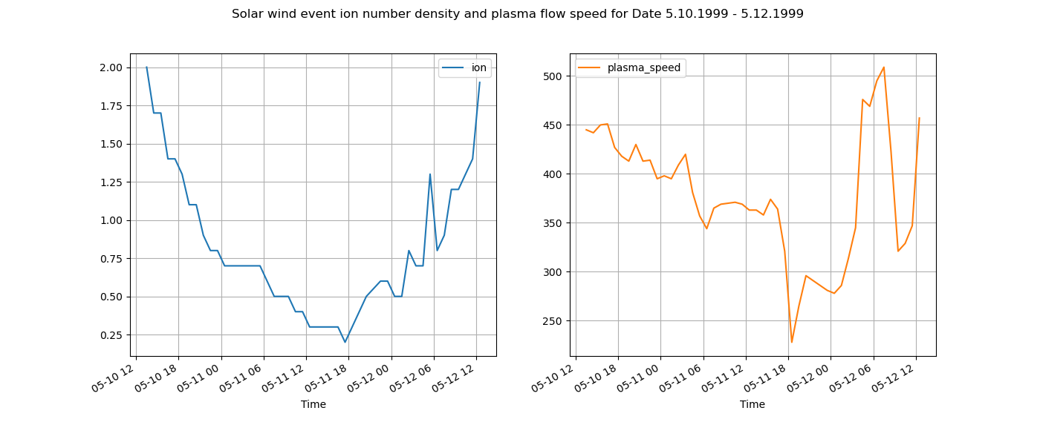
Visualization of ion number density and ion number density (per cc) Data 10-12 May 1999:
ion number density (per cc)
plasma flow speed (km/s)
Min =0.2, 278 max=507
Notes:
Min =0.2, 278 max=507

Slide 7
3) Calculate radius magnetopause

Slide 8
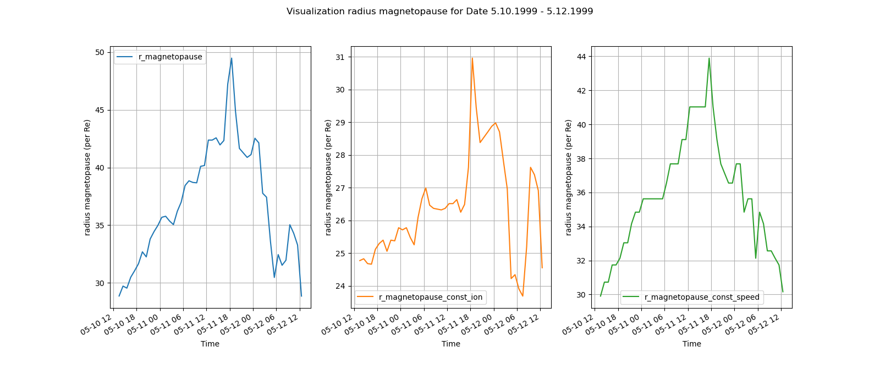

Visualization radius magnetopause Data 10-12 May 1999:
$R_{bow}=$[${\frac{{B_{0}}^{2}}{2μ_{o}m_{p}\left[n_{sw}\right]{\left[v_{sw}\right]}^{2}}]}^{\frac{1}{6}}{.R}_{E}$
$$n_{sw}=number of density$$
$$v_{sw}=solar wind velocity$$

Slide 9
4) Study maximum sunspot number observed solar cycle 23,24

Slide 10
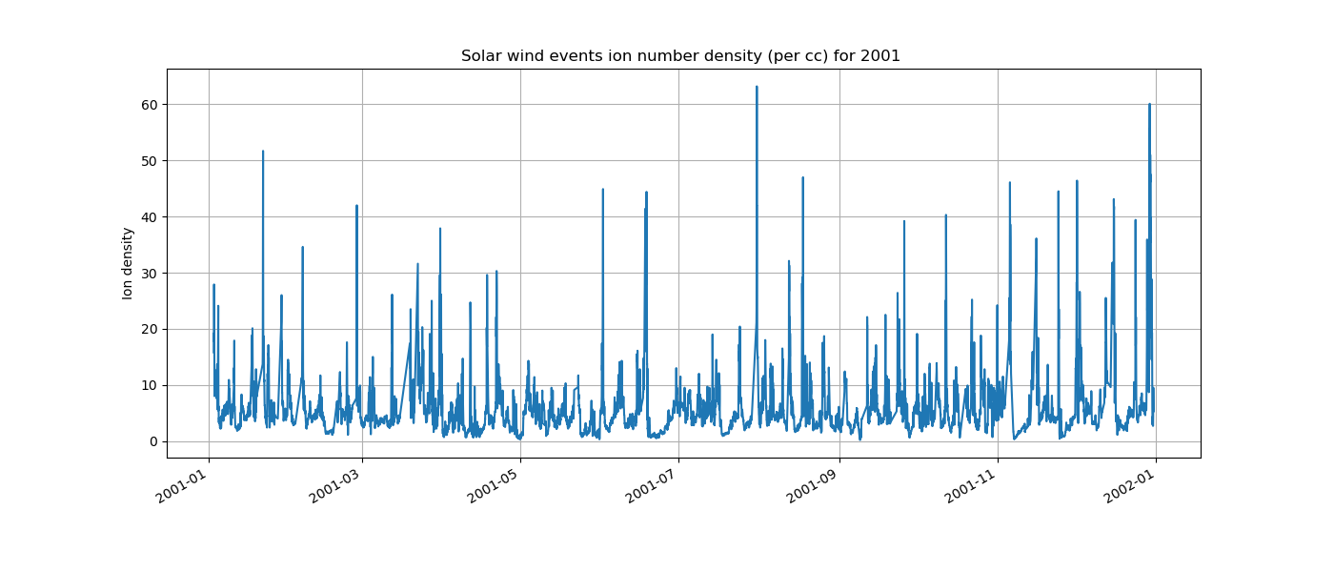
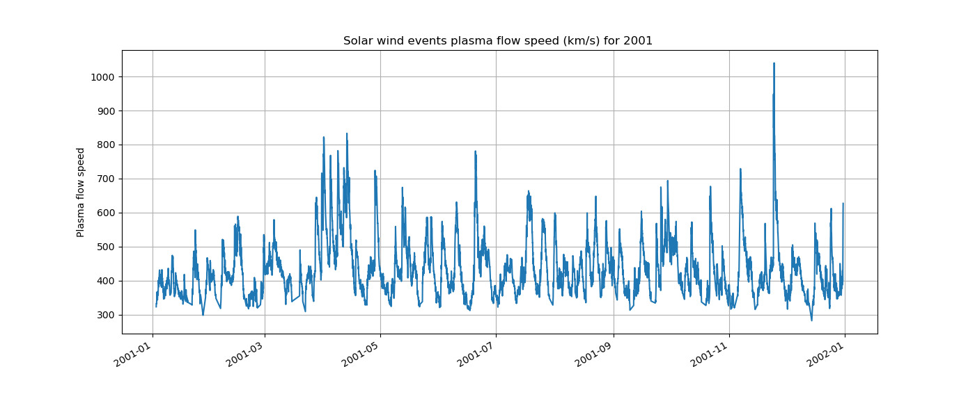
Visualization normal distribution for the year 2001 ion number density and plasma flow speed :
ion number density = 63.2 (per cc) 07-31 at 03:30:00
plasma flow speed = 1040 km/s 11-24 at 14:30:00
The 2001 year contained 7660 rows and the 2014 year contained 8475 rows
Notes:
The 2001 year contained 7660 rows and the 2014 year contained 8475 rows

Slide 11
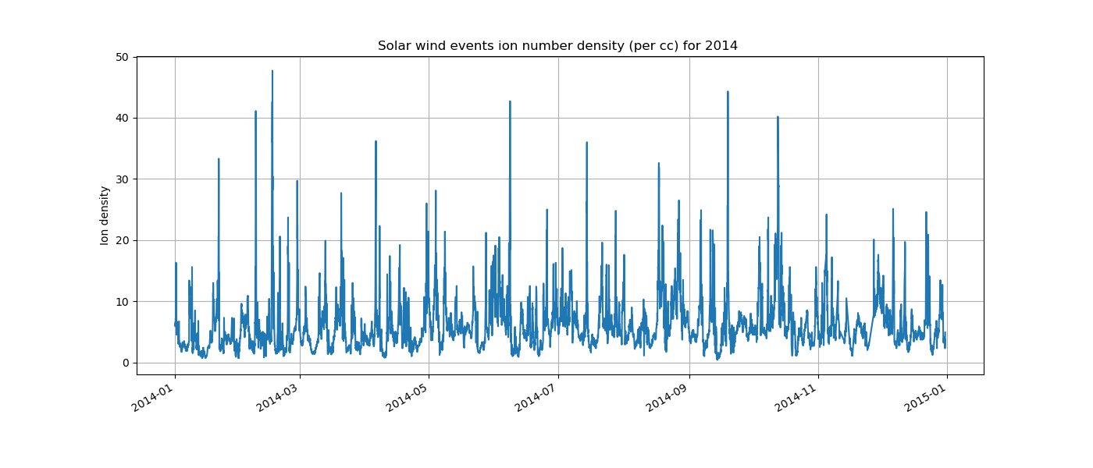
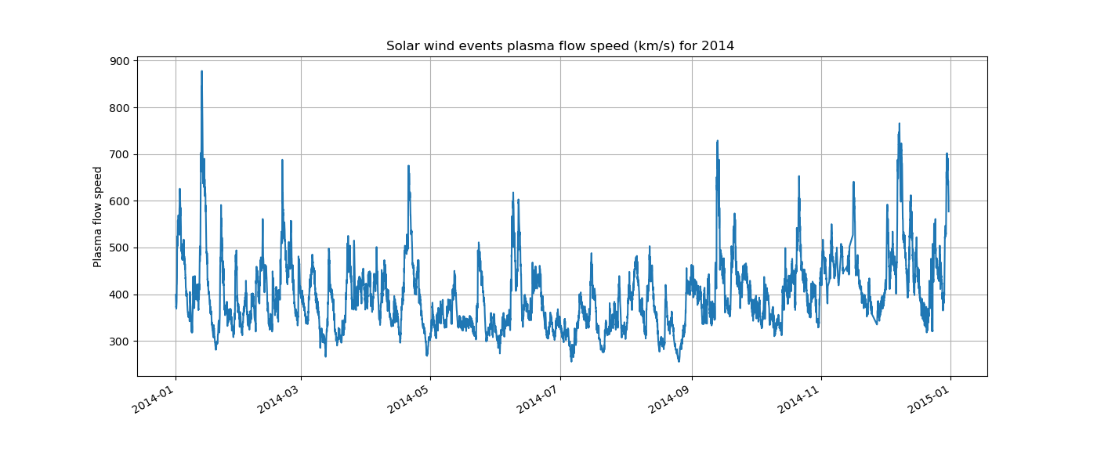
Visualization normal distribution for the year 2014 ion number density and plasma flow speed :
ion number density = 47.7 (per cc) 02-16 at 00:30:00
plasma flow speed = 878 km/s 01-13 at 07:30:00

Slide 12
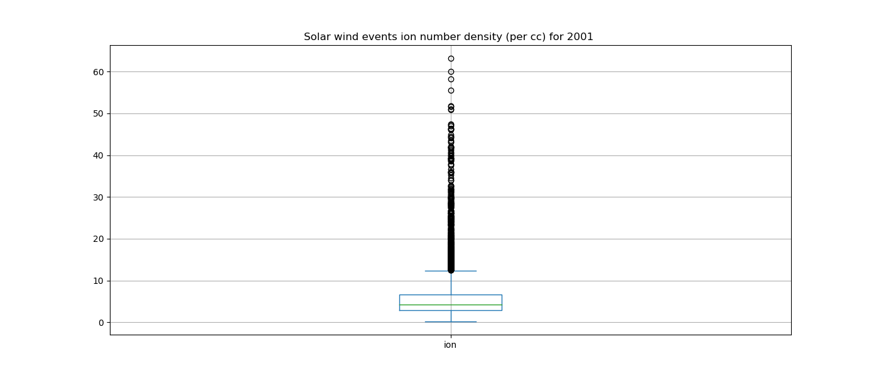
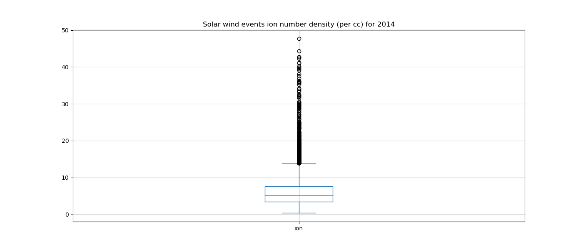
Visualization Box plot during the years 2001 and 2014 ion number density :
median ion number density = 4.3 (per cc)
median ion number density = 5.1 (per cc)
Notes:
show a dataset’s distribution and identify potential outliers

Slide 13
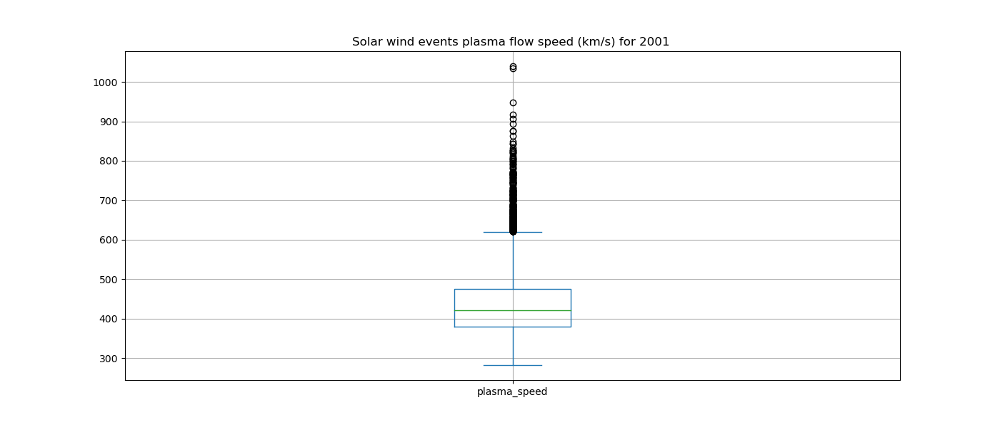
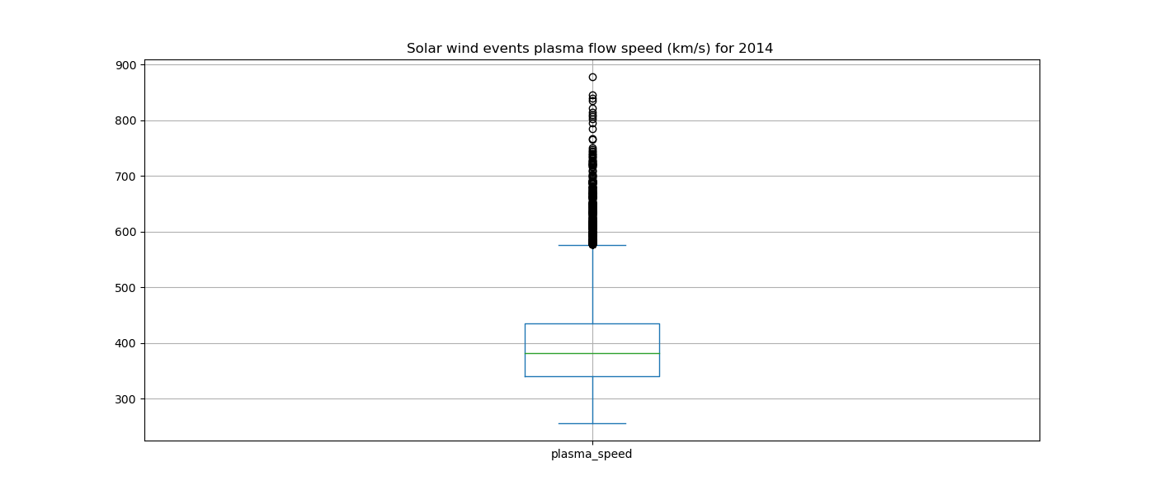
Visualization Box plot during the years 2001 and 2014 plasma flow speed :
median plasma flow speed value = 421 km/s
median plasma flow speed value = 382 km/s

Slide 14
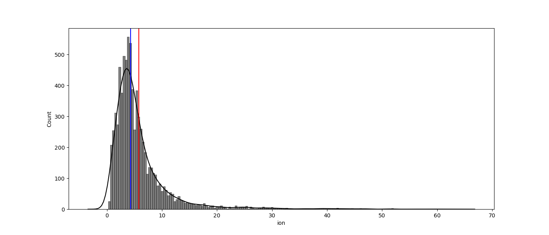
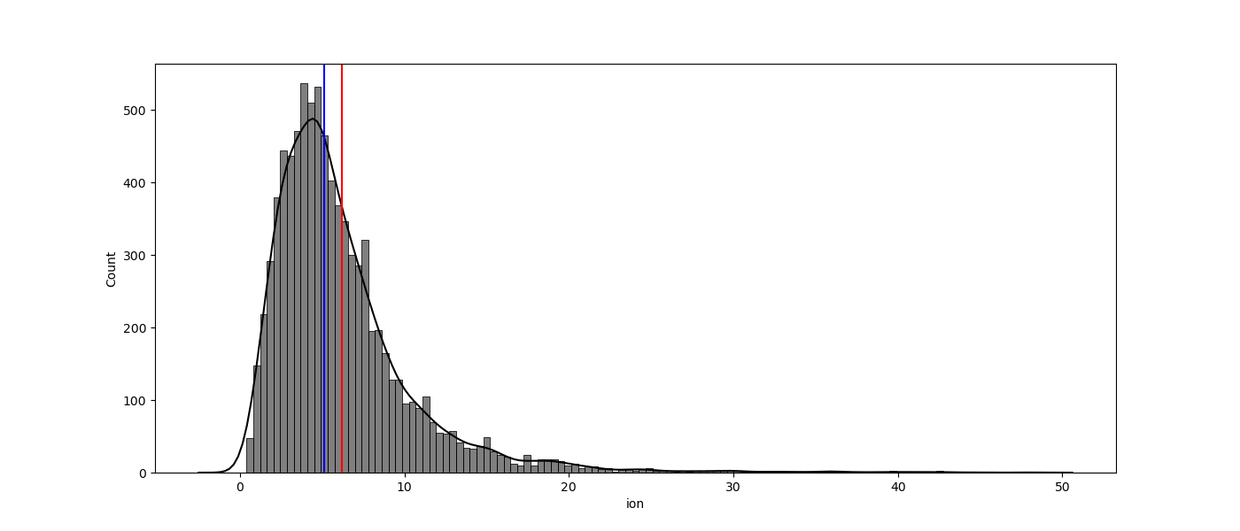
Visualization histogram plot during the years 2001 and 2014 ion number density :
ion number density during 2001
ion number density during 2014
median ion number density = 4.3 (per cc)
average ion number density = 5.79 (per cc)
median ion number density = 5.1 (per cc) average ion number density = 6.1981 (per cc)
Notes:
The purpose of using a histogram plot is to visualize the shape and spread of the data distribution and to identify any patterns or trends in the data,

Slide 15
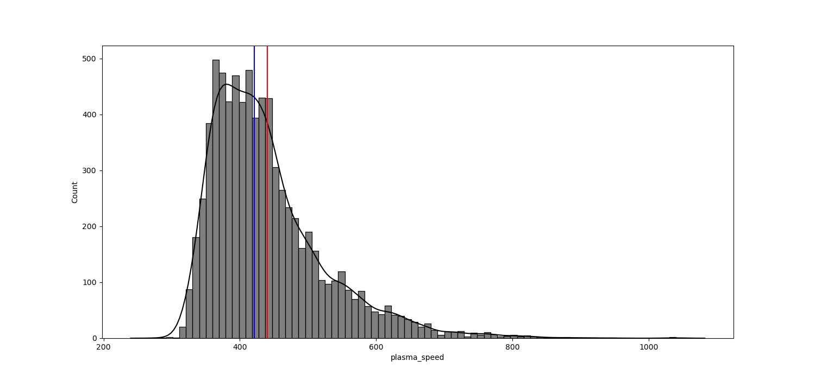
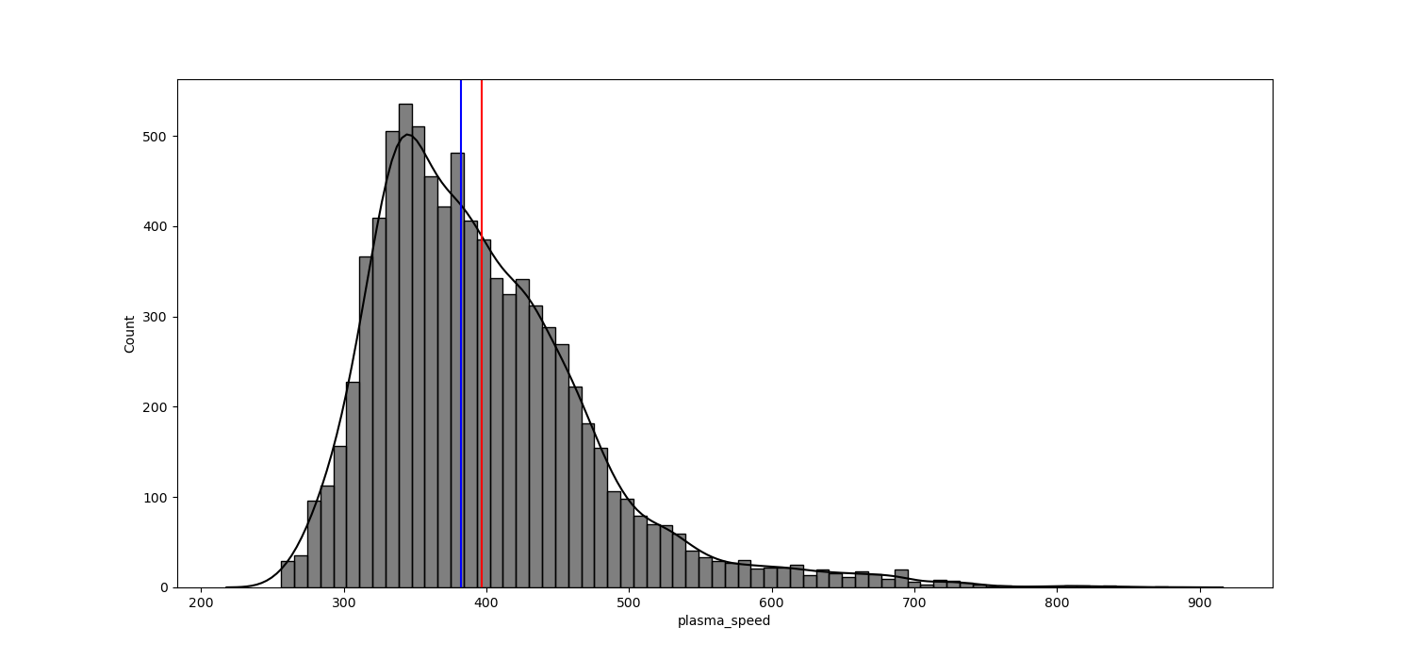
Visualization histogram plot during the years 2001 and 2014 plasma flow speed:
plasma flow speed during 2001
plasma flow speed during 2014
median plasma flow speed = 421 km/s
average plasma flow speed = 440.42 km/s
median plasma flow speed = 382 km/s
average plasma flow speed = 396.55 km/s

Slide 16
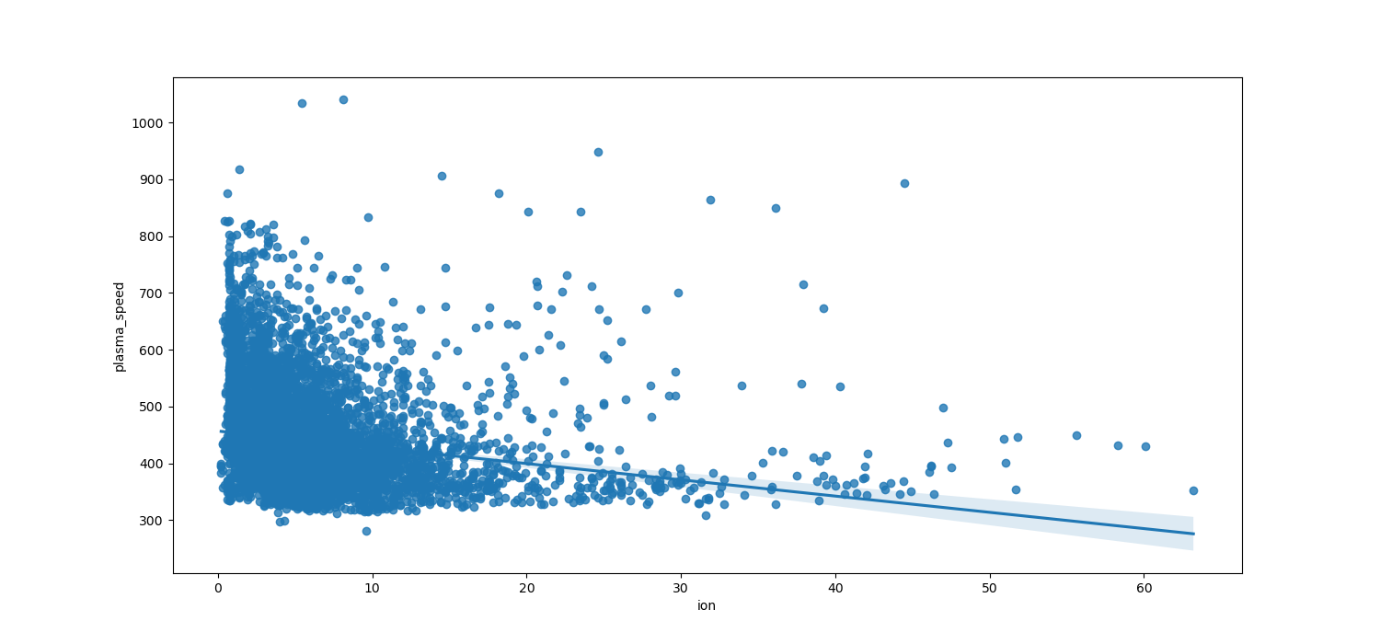
Visualization regression plot during the years 2001 ion number density and plasma flow speed :
ion number density and plasma flow speed for 2001
Notes:
visualize the relationship between two numerical variables. The purpose of using a regplot is to identify any patterns, trends, or associations between the variables and to visualize the strength and direction of the relationship.

Slide 17
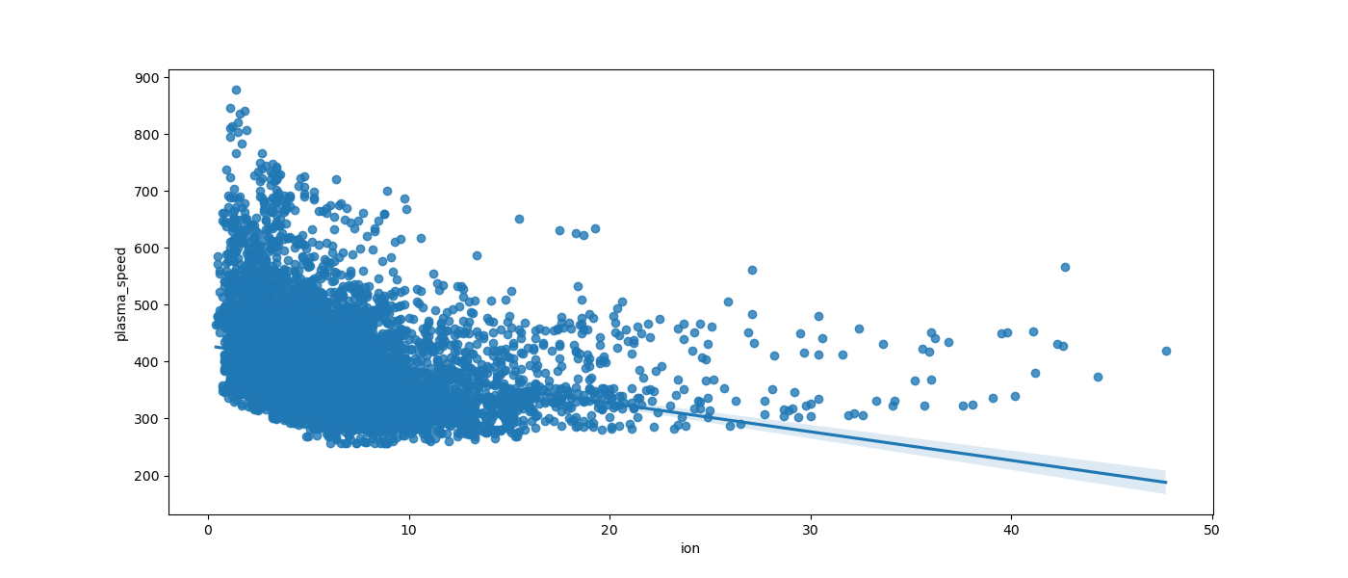
Visualization regression plot during the years 2014 ion number density and plasma flow speed :
ion number density and plasma flow speed for 2014

Slide 18
5) Prediction model on solar cycle 25 2023:2030

Slide 19
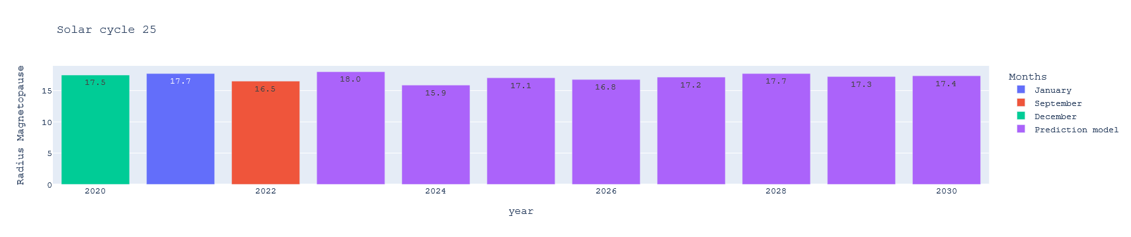
Prediction radius magnetopause from 2020: 2030

Slide 20
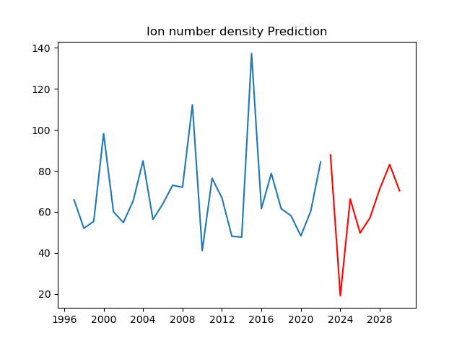
Prediction of ion number density from 2023 to 2030

Slide 21
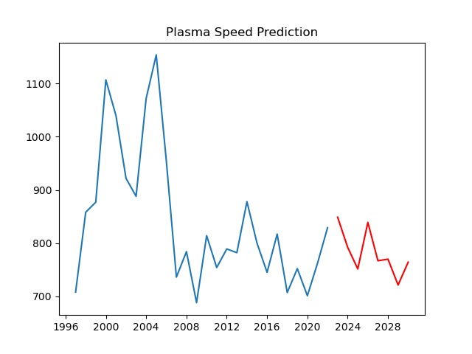
Prediction of plasma flow speed from 2023 to 2030

Slide 22
6) Prediction model on solar cycle 25 2023:2030

Slide 23
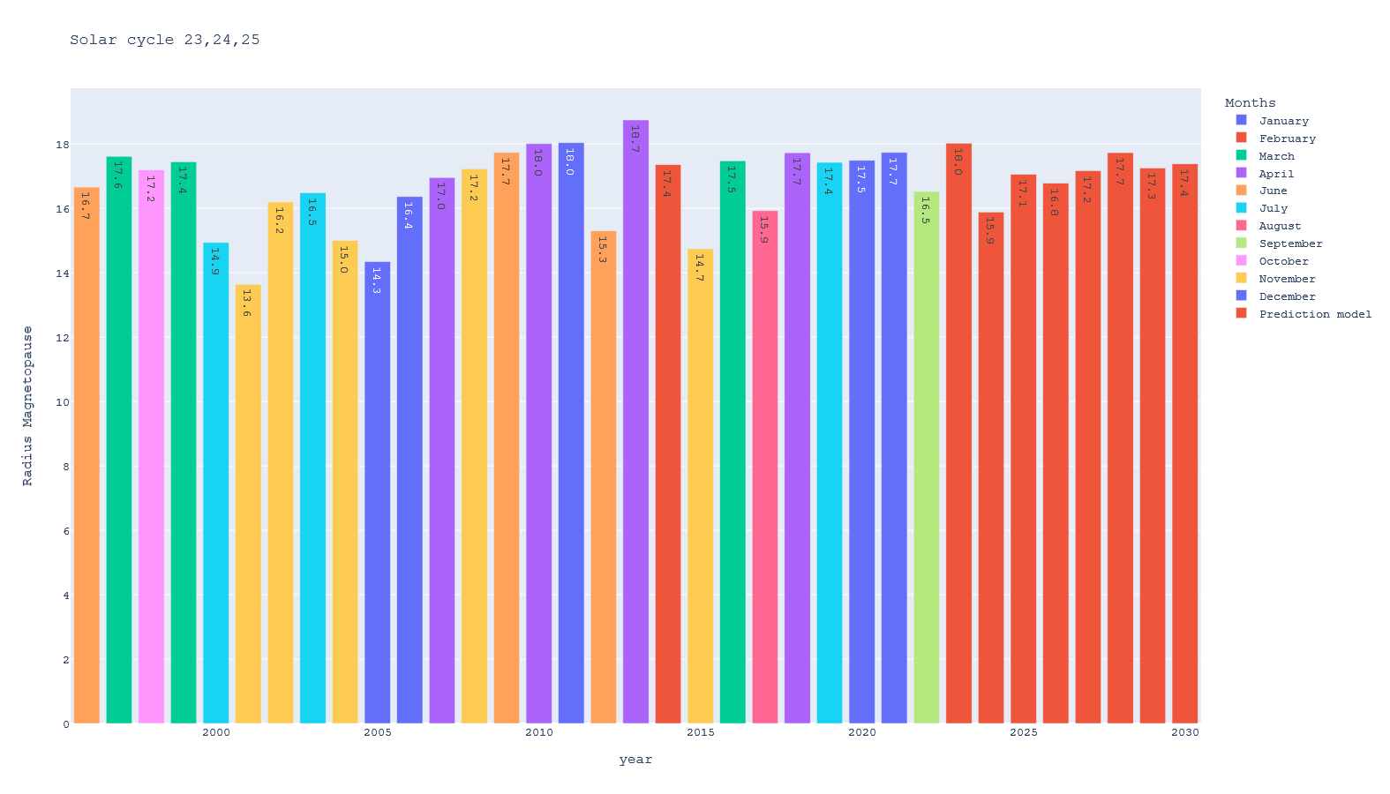
Visualization radius magnetopause from 1996 to 2030

Slide 24
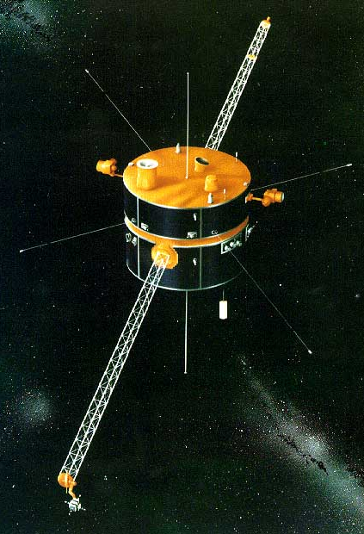
2) Data sources:
NASA’s Wind is a spin-stabilized spacecraft launched November 1, 1994, and placed in a halo orbit around the Sun-Earth L1 Lagrange point.
The spacecraft observes the solar wind that is about to impact the magnetosphere of Earth.
Link data source: https://cdaweb.gsfc.nasa.gov/
Link source code
https://github.com/mohamed2elsayed/Analysis-The-effects-of-solar-wind-on-the-magnetosphere.git

Slide 25
Project Code sample

Slide 26
